Slide 1
Questions - RefPaper 7-24-2024

Slide 2
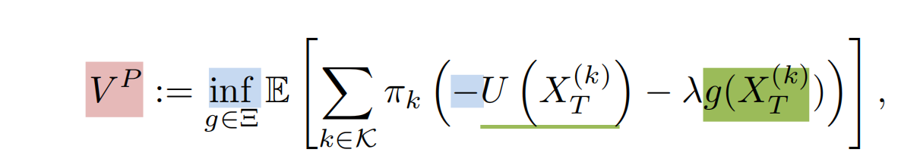
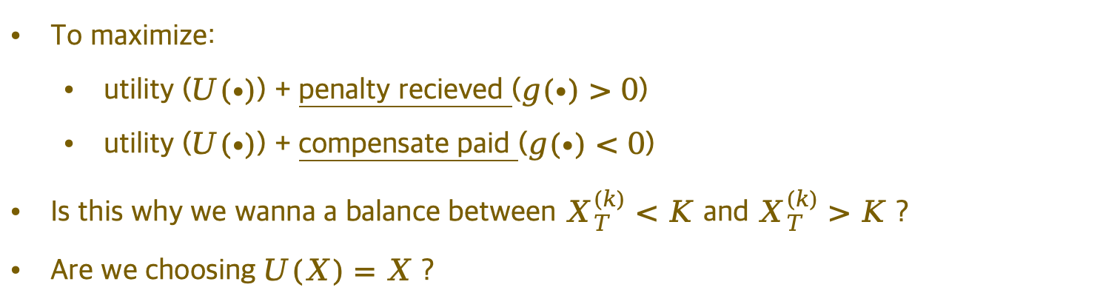
01 - Principle’s Problem
To maximize:
utility ($U(∙)$) + penalty recieved ($g(∙)>0$)
utility ($U(∙)$) + compensate paid ($g(∙)<0$)
Is this why we wanna a balance between $X_{T}^{(k)}<K$ and $X_{T}^{(k)}>K$ ?
Are we choosing $U(X)=X$ ?

Slide 3
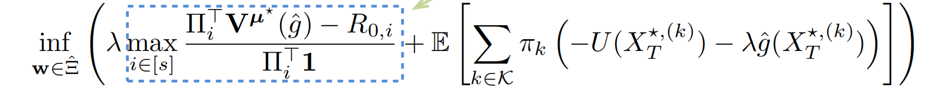
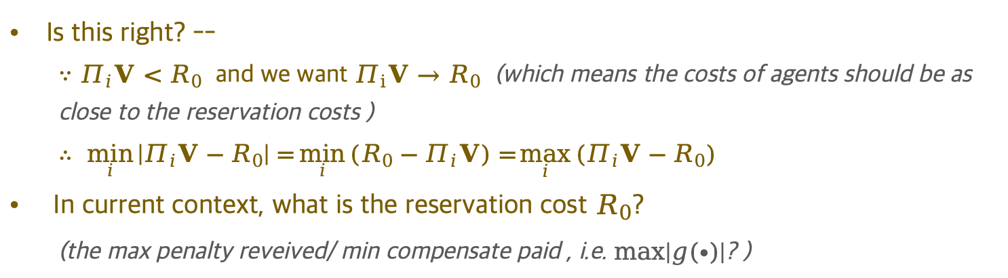
02 - Assumption of Principle’s Problem
Is this right? --
$∵Π_{i}V<R_{0}$ and we want $Π_{i}V→R_{0}$ (which means the costs of agents should be as close to the reservation costs )
$$∴ \min_{i}\left|Π_{i}V−R_{0}\right|=\min_{i}{(R_{0}−Π_{i}V)=}\max_{i}{(Π_{i}V−R_{0})}$$
In current context, what is the reservation cost $R_{0}$?
(the max penalty reveived/ min compensate paid , i.e. $max\left|g(∙)\right|$? )

Slide 4
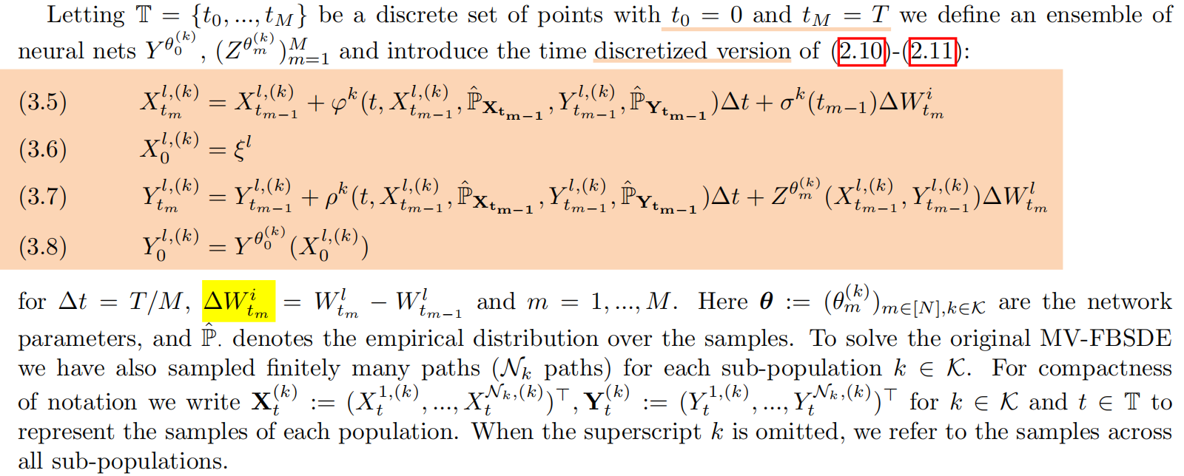

03 - Should instead be $∆W_{t_{m}}^{l}$ ?
Page 9, [3.2. Approximating the MV-FBSDE]

Slide 5
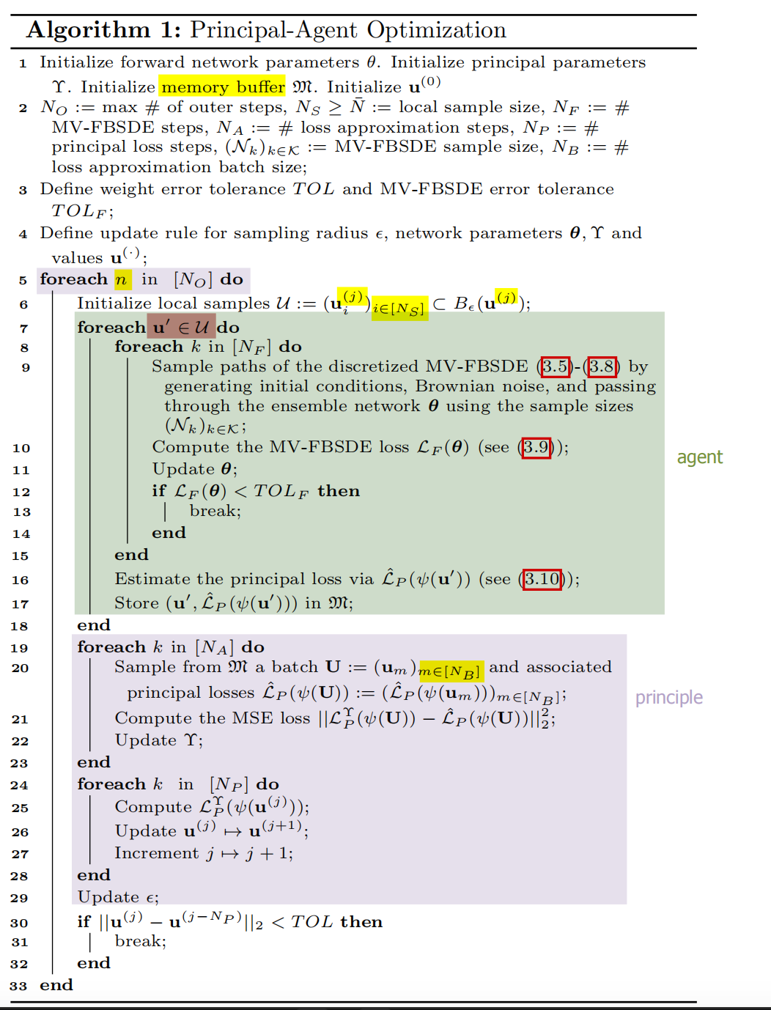
04 - What Is U ?

Slide 6
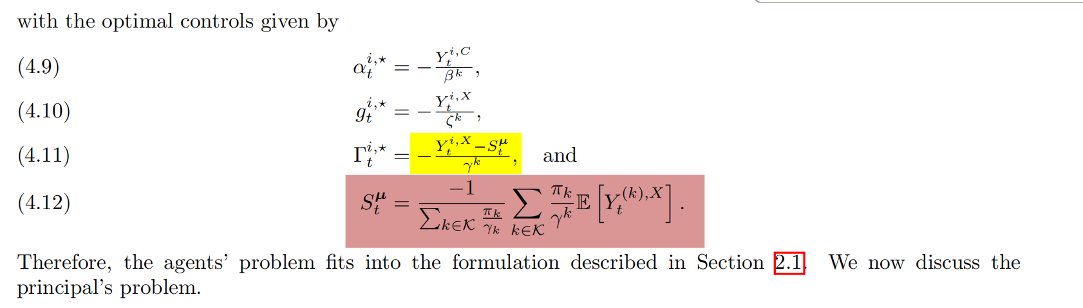
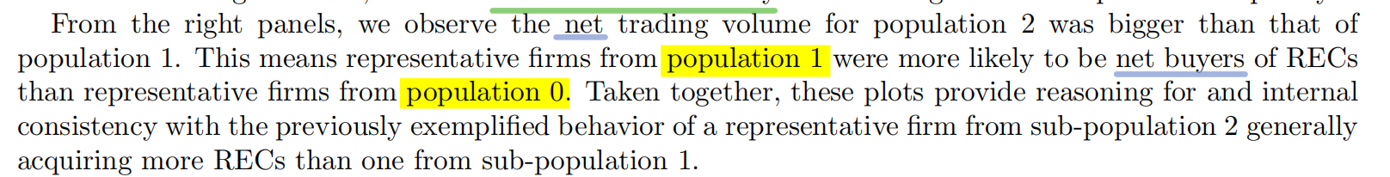
05 - Sign In Front of $Γ or S$
Page 13

Slide 7
06 - Should Instead Be Pop2 & Pop1 ?
Page 18

